Slide 1
Organization of Concert

Slide 2
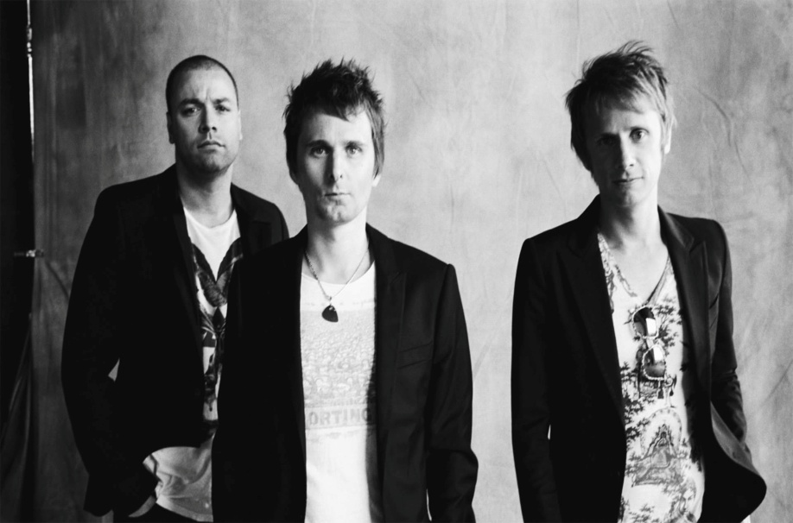
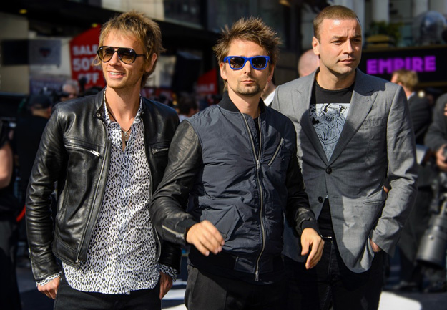
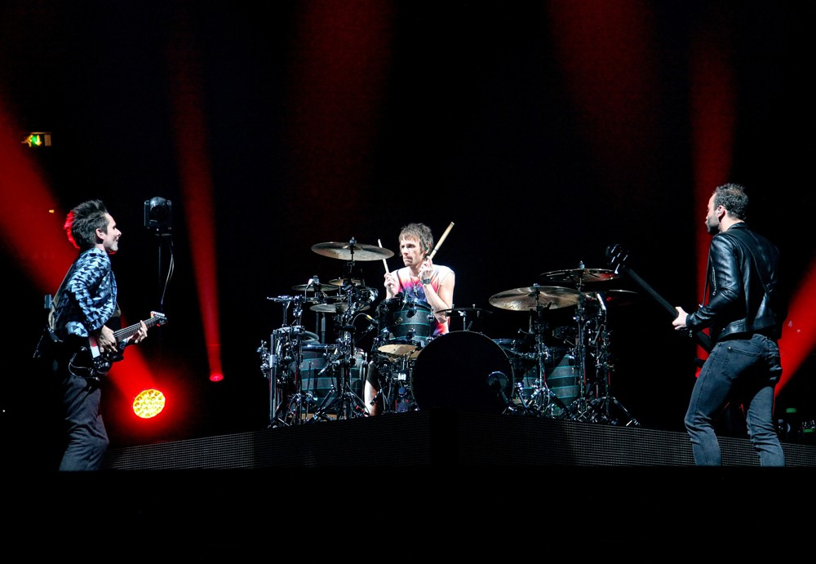
MUSE
English rock band
1994
Matthew Bellamy
Christopher Wolstenholme
Dominic Howard
Energetik live performances
Price: 5 000 000 UAH (FC)

Slide 3
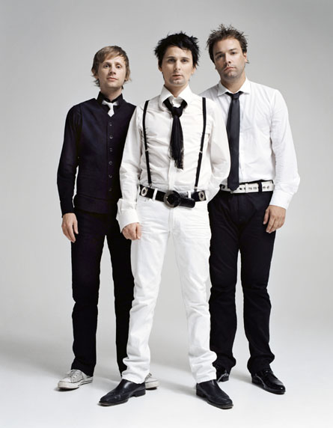
Why Muse are one of the best band ever?
Non-stop stage action
Great songs that rock
They change the setlist up
Ticket prices were not horribly expensive
Great use of covers
Great stage set up
The band is nice to fans

Slide 4
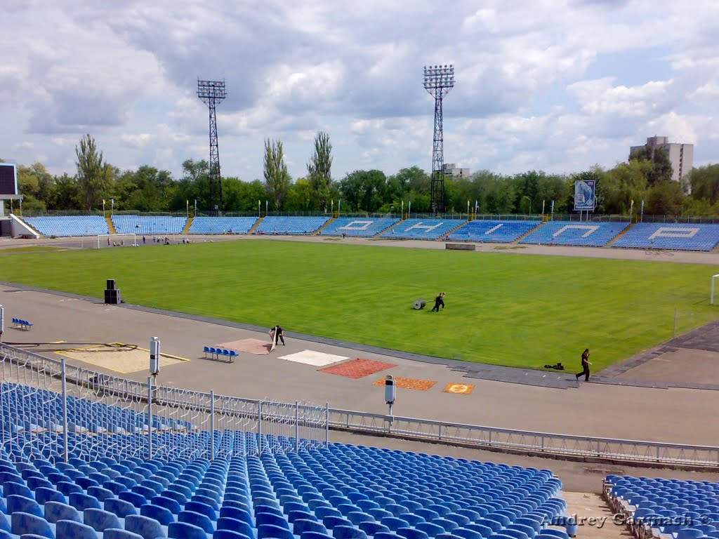
Venue – Stadium Meteor
Capacity : 14000 seats+6000 (fan-zones) +120 seats (for VIP)
Total: 20120
Regularly used for
concerts
Convenient location
Liked by bands
Price: 200 000 UAH
(FC)

Slide 5
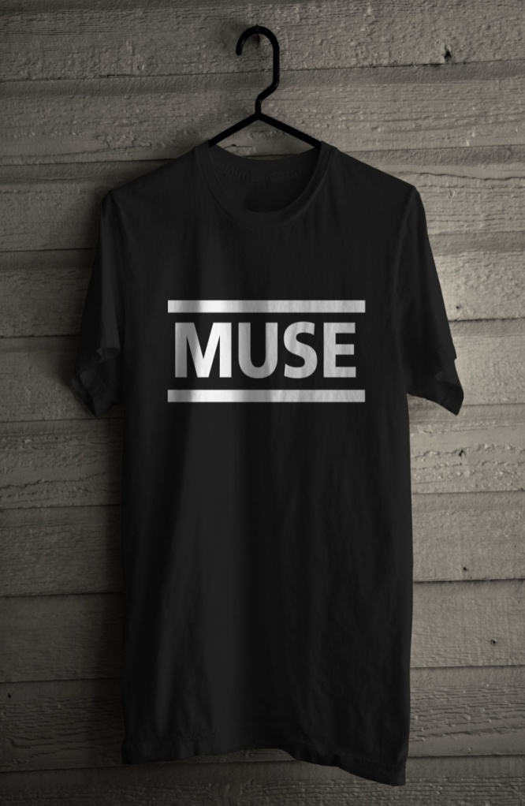
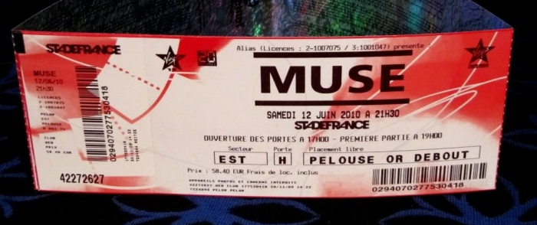
Marketing (VC)
70 Billboards – 2000 UAH per each a month – 3 months – 10 000 UAH – 420 000 UAH
TV advertising (1+1 channel) –
500 000 UAH
Radio advertising (Hit Fm, Europa plus) – 50 00o UAH
Internet-advertising – 50 000 UAH
Souvenirs
1000 Posters – 5 UAH per each (cost).
Price – 10 UAH
1000 T-shirts – 120 UAH.
Price – 200 UAH.
3000 Badges – 4 UAH.
Price – 8 UAH.

Slide 6
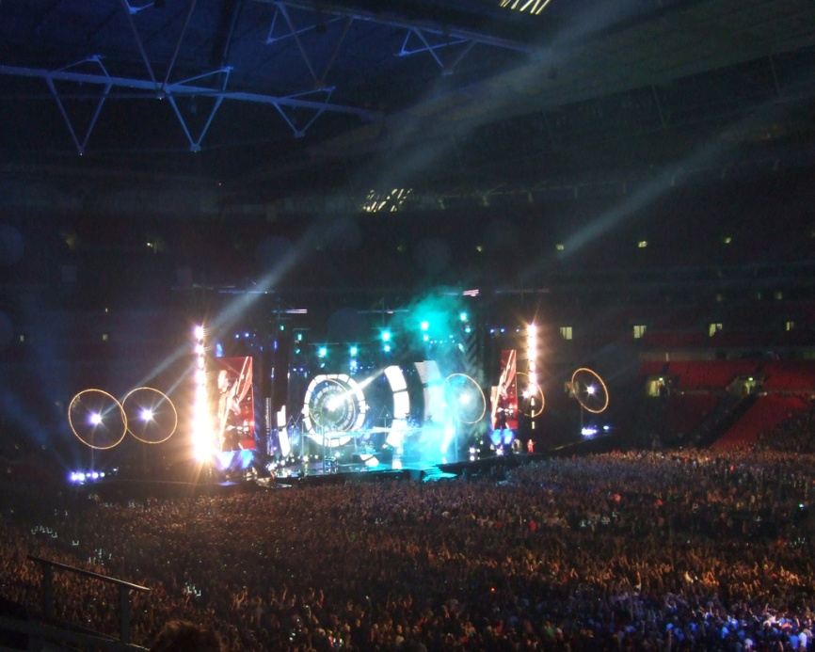
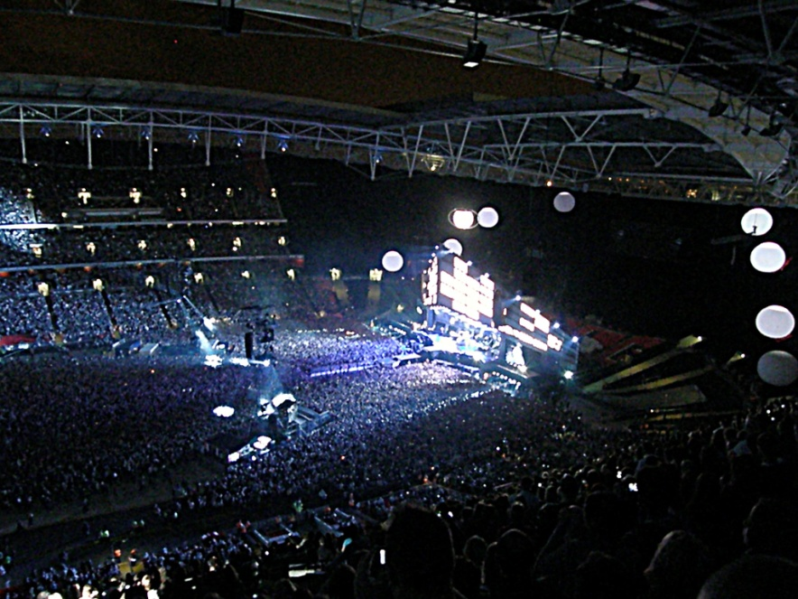
Stage, Power and Lightning
Mounting the stage - 140 000 UAH (FC)
Rental of modular coverings for natural grass "Terralife“ – 95 000 UAH (VC) The band brings other equipments, including lighting

Slide 7
Health and Safety (FC)
10 paramedical teams (consist of 6 professionals)
3000 UAH*10 = 30 000 UAH

Slide 8
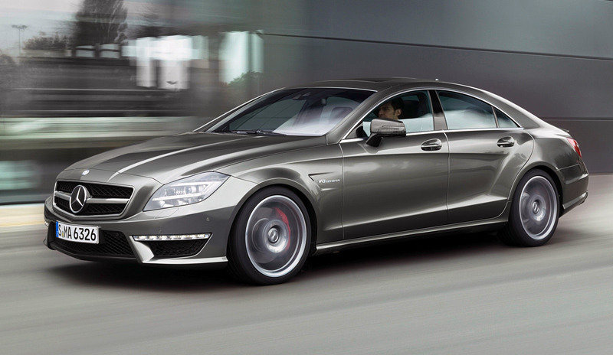
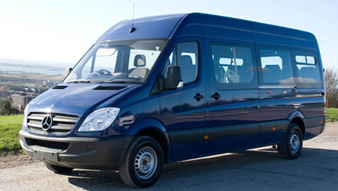
Transport (VC)
For Muse:
Airline tickets
London-Dnepropetrovsk-London:
9 first class seats - 330 229 UAH
10 economy class seats - 173 676 UAH
Rental of Mercedes-Benz car (2 days) – 120 000 UAH Rental of three Mercedes Sprinter minibuses (2 days) - 180 000 UAH
For fans:
Rental of thirteen Mercedes Sprinter minibuses (4 hours)- 39 000 UAH

Slide 9
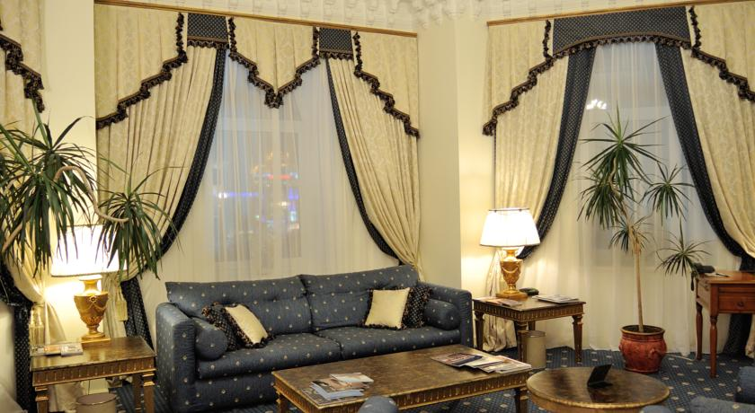
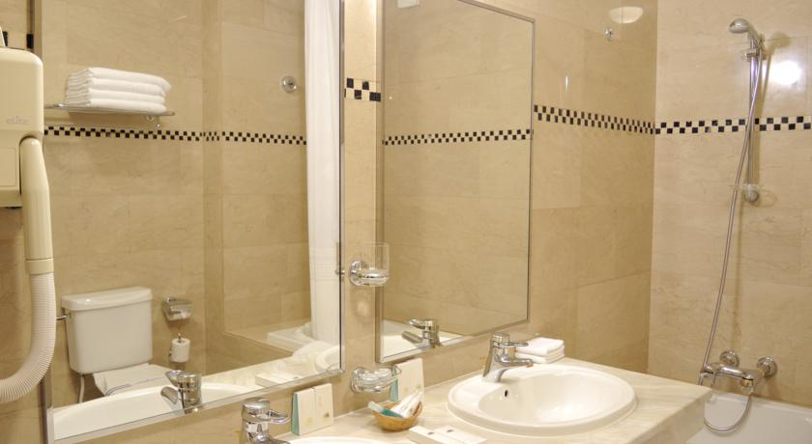
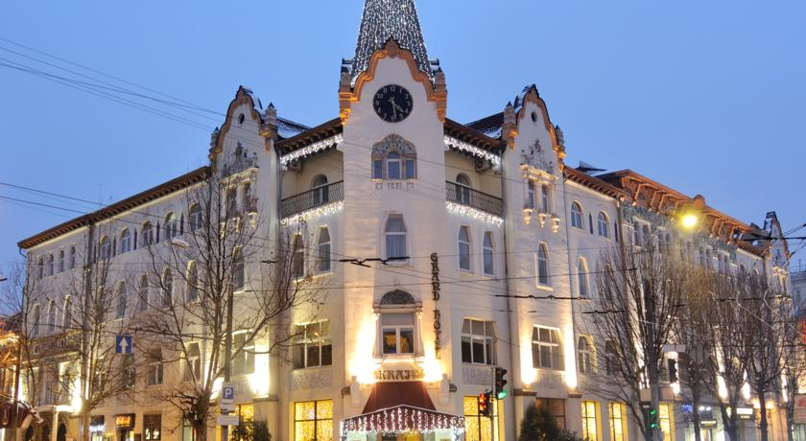
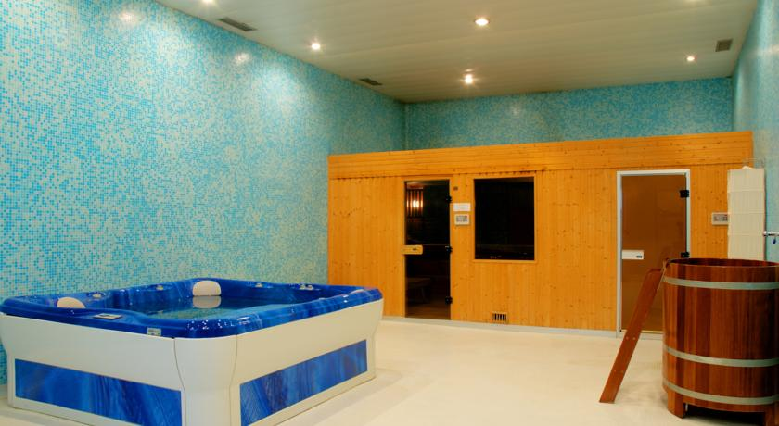
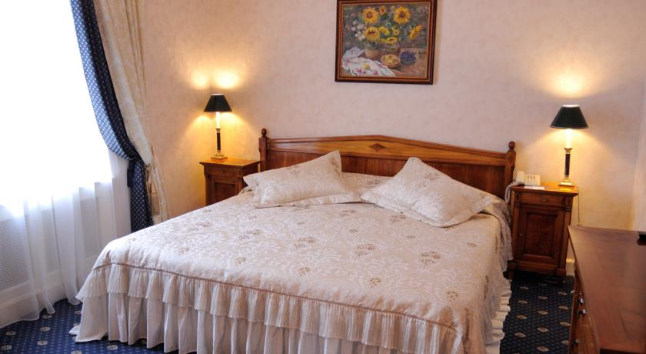
Rider-list costs(VC)
Hotel - Grand Hotel Ukraine– 4*
1 Presidential Suite – 12 816 UAH
5 Superior Suites – 32 000 UAH
7 Junior Suites – 24 888 UAH
Meals
20 000 UAH a day for 19 persons
Total: 40 000 UAH

Slide 10
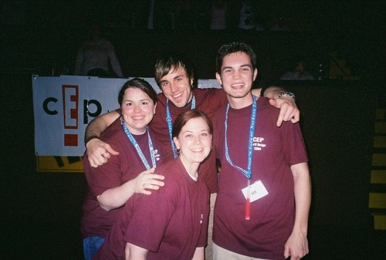
Staff (FC)
100 volunteers (ticket-control, cleaning)
50 professionals (ticket-control, cleaning) – 15 000 UAH
100 Stewards – 5000 UAH

Slide 11
Sponsorship
PrivatBank (ПриватБанк)
Epicenter (Епіцентр)
Epicenter - 137 000UAH for covering the cost of souvenirs.
PrivatBank - 200 000 UAH for partly covering advertising cost and for printing the tickets.
As a sigh of gratitude we offer each sponsor:
their advertisement broadcasting during the concert;
20 VIP-tickets

Slide 12
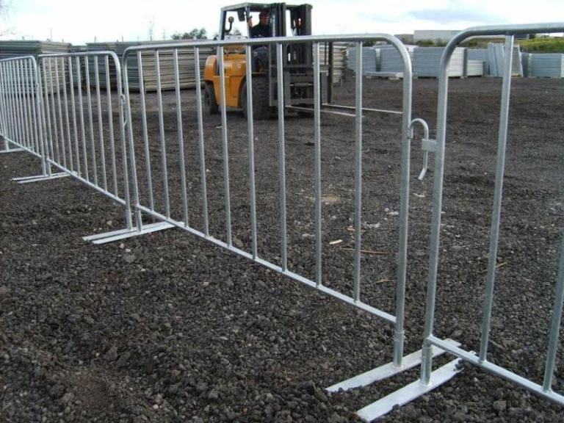
License (FC) and Crowd Control (FC)
According to the law of Ukraine, organization of concert is lawful without a license.
It is necessary to have Crowd Control Barriers: 20 120 people, budget 2 900 UAH per 1 000 attendees = 60 900UAH

Slide 13
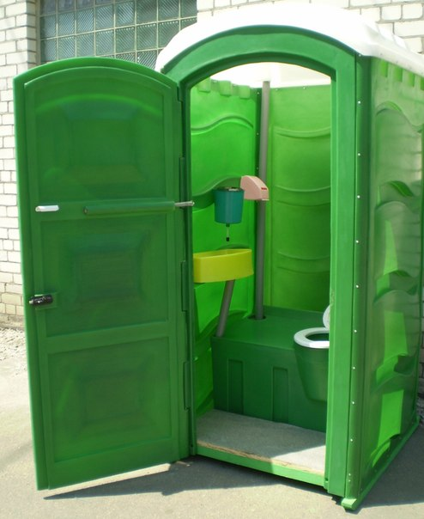
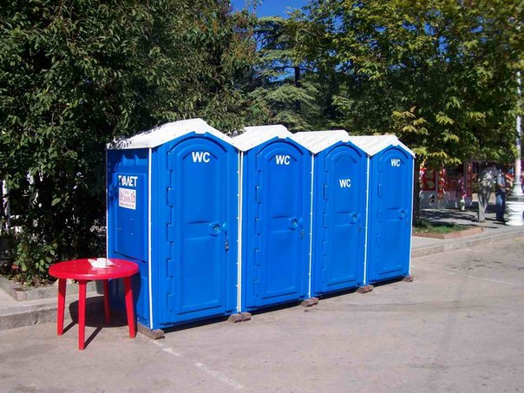
Lavatory Facilities (FC)
Our attendees are going to be on site for a long period of time so we need to provide them with lavatory facilities.
200 UAH/day per 500 attendees =
8 400 UAH

Slide 14
Police (FC) and Security (FC)
For attendees - 320 UAH/hour for 1 security guard;
1 guard per 100 ticket sold;
20 000 tickets = 20 guards;
5 hour-concert (1 600UAH/guard) =
32 000 UAH
For the band - 170 UAH/hour for 1 security guard;
24 hours = 4080 UAH/guard;
5 guards = 20 400 UAH

Slide 15
Outsourcing company (FC)
Ticketing was outsourced to a professional agency (double-sided printed tickets with barcode)
2 280 UAH per 1 000 tickets;
20 120 tickets = 45 874 UAH

Slide 16
Unexpected costs (VC)
Our company left 500 000UAH for unexpected costs (in case of problems with the transport, staff, police, marketing)

Slide 17
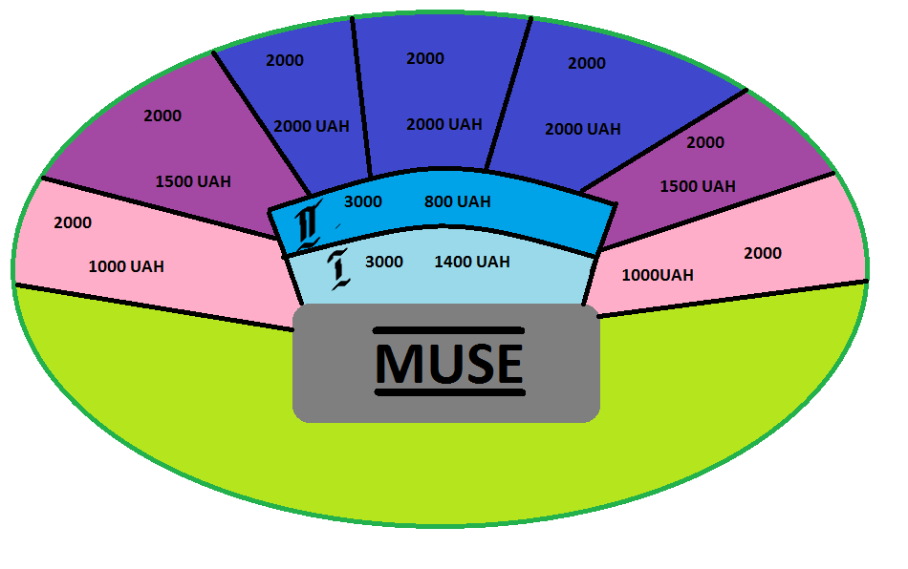
Tickets

Slide 18
Costs and Profit
Variable costs
Total Variable costs – 2 704 609 UAH
Item | Unit cost, UAH | Number | Total cost, UAH
Marketing | - | - | 1 157 000
Billboards | 2000*3 months | 70 | 420 000
Advertising | - | - | 600 000
Souvenirs | - | - | 137 000
Modular coverings | - | - | 95 000
Transport for band | - | - | 803 905
Transport for fans | - | - | 39 000
Unexpected costs | - | - | 500 000
Rider-list costs | - | - | 109 704

Slide 19
Fixed costs
Total fixed costs – 5 557 574 UAH
Item | Unit cost, UAH | Number | Total cost, UAH
Band price | - | - | 5 000 000
Venue | - | - | 200 000
Stage | - | - | 140 000
Health and safety | - | - | 30 000
Staff | - | - | 20 000
Crowd control barriers | 2900 | 21 | 60 900
Lavatory facilities | 200 | 42 | 8 400
Police and Security for fans | 1600 | 20 | 32 000
Police and Security for band | 4080 | 5 | 20 400
Tickets | 2, 28 | 20120 | 45 874

Slide 20
Total costs: 8 262 183 UAH
Concert profit - 28 920 000 UAH
4000 tickets* 1000UAH = 4 000 000 UAH
4000 tickets*1500 UAH = 6 000 000 UAH
6000 tickets*2000 UAH = 12 000 000 UAH
80 tickets*4000 UAH = 320 000 UAH
3000 tickets*1400 UAH = 4 200 000 UAH
3000 tickets*800 UAH = 2 400 000 UAH
Extra-profit: from souvenirs – 97 000 UAH
Sponsorship bonus: 337 000 UAH

Slide 21
Total concert profit=
=28 920 000 UAH - 8 262 183 UAH+ 97 000 UAH+ 337 000 UAH=
21 091 817 UAH

